Slide 1
융복합 프로젝트 또왔슈
안면인식 기반
단골 관리 시스템
AI_송재근
빅데이터_이동규
클라우드_이윤식, 윤서율
IoT_이건영

Slide 2
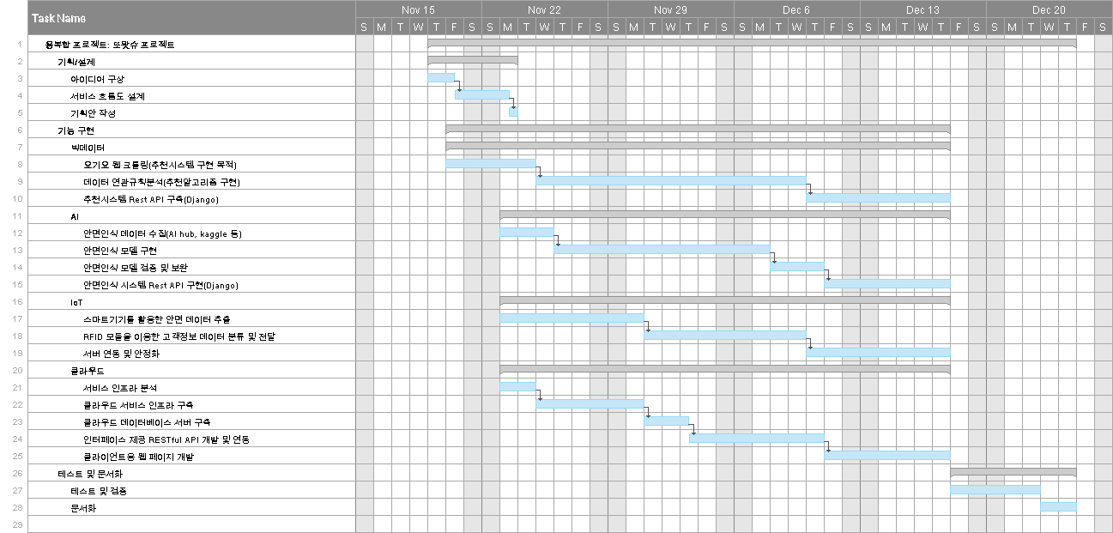
WBS Work Breakdown Structure

Slide 3














프로젝트 수행도구

Slide 4
PPT PRESENTATION
Enjoy your stylish business and campus life with BIZCAM

Slide 5
PPT PRESENTATION
Enjoy your stylish business and campus life with BIZCAM

Slide 6
PPT PRESENTATION
Enjoy your stylish business and campus life with BIZCAM

Slide 7
PPT PRESENTATION
Enjoy your stylish business and campus life with BIZCAM

